Slide 1
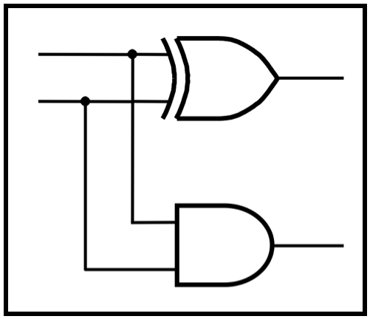
CprE 281:
Digital Logic
Instructor: Alexander Stoytchev
http://www.ece.iastate.edu/~alexs/classes/

Slide 2
Registers and Counters
CprE 281: Digital Logic
Iowa State University, Ames, IA
Copyright © Alexander Stoytchev

Slide 3
Administrative Stuff
The second midterm is this Friday.
Homework 8 is due today.
Homework 9 is out. It is due on Mon Nov 7.
No HW due next Monday

Slide 4
Administrative Stuff
Midterm Exam #2
When: Friday October 28 @ 4pm.
Where: This classroom
What: Chapters 1, 2, 3, 4 and 5.1-5.8
The exam will be open book and open notes (you can bring up to 3 pages of handwritten notes).

Slide 5
Registers

Slide 6
Register
(Definition)
An n-bit structure consisting of flip-flops

Slide 7
Parallel-Access Register

Slide 8
1-Bit Parallel-Access Register
Load
0
D
Q
Out
In
1
Q
Clock

Slide 9
1-Bit Parallel-Access Register
Load
0
D
Q
Out
In
1
Q
Clock
The 2-to-1 multiplexer is used to select whether to load a new value into the D flip-flop or to retain the old value.
The output of this circuit is the Q output of the flip-flop.

Slide 10
1-Bit Parallel-Access Register
Load
0
D
Q
Out
In
1
Q
Clock
If Load = 0, then retain the old value.
If Load = 1, then load the new value from In.

Slide 11
2-Bit Parallel-Access Register
Out_1
Out_0
Load
0
0
D
Q
D
Q
1
1
Q
Q
Clock
In_1
In_0

Slide 12
2-Bit Parallel-Access Register
Parallel Output
Out_1
Out_0
Load
0
0
D
Q
D
Q
1
1
Q
Q
Clock
In_1
In_0
Parallel Input

Slide 13
3-Bit Parallel-Access Register
Out_2
Out_1
Out_0
Load
0
0
0
D
Q
D
Q
D
Q
1
1
1
Q
Q
Q
Clock
In_2
In_1
In_0
Notice that all flip-flops are on the same clock cycle.

Slide 14
3-Bit Parallel-Access Register
Parallel Output
Out_2
Out_1
Out_0
Load
0
0
0
D
Q
D
Q
D
Q
1
1
1
Q
Q
Q
Clock
In_2
In_1
In_0
Parallel Input

Slide 15
4-Bit Parallel-Access Register
Out_3
Out_2
Out_1
Out_0
Load
0
0
0
0
D
Q
D
Q
D
Q
D
Q
1
1
1
1
Q
Q
Q
Q
Clock
In_3
In_2
In_1
In_0

Slide 16
4-Bit Parallel-Access Register
Parallel Output
Out_3
Out_2
Out_1
Out_0
Load
0
0
0
0
D
Q
D
Q
D
Q
D
Q
1
1
1
1
Q
Q
Q
Q
Clock
In_3
In_2
In_1
In_0
Parallel Input

Slide 17
Shift Register

Slide 18
A simple shift register
Q
Q
Q
Q
In
D
Q
1
D
Q
2
D
Q
3
D
Q
4
Out
Clock
Q
Q
Q
Q
[ Figure 5.17a from the textbook ]

Slide 19
A simple shift register
Q
Q
Q
Q
In
D
Q
1
D
Q
2
D
Q
3
D
Q
4
Out
Clock
Q
Q
Q
Q
Positive-edge-triggered
D Flip-Flop

Slide 20
A simple shift register
Q
Q
Q
Q
In
D
Q
1
D
Q
2
D
Q
3
D
Q
4
Out
Clock
Q
Q
Q
Q
Master
Slave
Q
m
Q
D
D
Q
D
Q
s
Q
Clock
Clk
Q
Clk
Q
Q

Slide 21
A simple shift register
Q
Q
Q
Q
In
D
Q
1
D
Q
2
D
Q
3
D
Q
4
Out
Clock
Q
Q
Q
Q
D –Flip-Flop
Master
Slave
Q
m
Q
D
D
Q
D
Q
s
Q
Clock
Clk
Q
Clk
Q
Q
Gated D-Latch
Gated D-Latch

Slide 22
A simple shift register
Q
Q
Q
Q
In
D
Q
1
D
Q
2
D
Q
3
D
Q
4
Out
Clock
Q
Q
Q
Q

Slide 23
A simple shift register
Q
Q
Q
Q
In
D
Q
1
D
Q
2
D
Q
3
D
Q
4
Out
Clock
Q
Q
Q
Q
Master
Slave
Master
Slave
Master
Slave
Master
Slave
In
D
Q
D
Q
D
Q
D
Q
D
Q
D
Q
D
Q
D
Q
Clock
Q
Q
Q
Q
Clk
Q
Clk
Q
Clk
Q
Clk
Q
Clk
Clk
Clk
Clk

Slide 24
A simple shift register
Q
Q
Q
Q
In
D
Q
1
D
Q
2
D
Q
3
D
Q
4
Out
Clock
Q
Q
Q
Q
Master
Slave
Master
Slave
Master
Slave
Master
Slave
In
D
Q
D
Q
D
Q
D
Q
D
Q
D
Q
D
Q
D
Q
Clock
Q
Q
Q
Q
Clk
Q
Clk
Q
Clk
Q
Clk
Q
Clk
Clk
Clk
Clk

Slide 25
A simple shift register
Q
Q
Q
Q
In
D
Q
1
D
Q
2
D
Q
3
D
Q
4
Out
Clock
Q
Q
Q
Q
Master
Slave
Master
Slave
Master
Slave
Master
Slave
In
D
Q
D
Q
D
Q
D
Q
D
Q
D
Q
D
Q
D
Q
Clock
Q
Q
Q
Q
Clk
Q
Clk
Q
Clk
Q
Clk
Q
Clk
Clk
Clk
Clk

Slide 26
A simple shift register
Q
Q
Q
Q
In
D
Q
1
D
Q
2
D
Q
3
D
Q
4
Out
Clock
Q
Q
Q
Q
Master
Slave
Master
Slave
Master
Slave
Master
Slave
In
D
Q
D
Q
D
Q
D
Q
D
Q
D
Q
D
Q
D
Q
Clock
Q
Q
Q
Q
Clk
Q
Clk
Q
Clk
Q
Clk
Q
Clk
Clk
Clk
Clk

Slide 27
A simple shift register
Q
Q
Q
Q
In
D
Q
1
D
Q
2
D
Q
3
D
Q
4
Out
Clock
Q
Q
Q
Q
Master
Slave
Master
Slave
Master
Slave
Master
Slave
In
D
Q
D
Q
D
Q
D
Q
D
Q
D
Q
D
Q
D
Q
Clock
Q
Q
Q
Q
Clk
Q
Clk
Q
Clk
Q
Clk
Q
Clk
Clk
Clk
Clk

Slide 28
A simple shift register
Master
Slave
Master
Slave
Master
Slave
Master
Slave
In
D
Q
D
Q
D
Q
D
Q
D
Q
D
Q
D
Q
D
Q
Clock
Q
Q
Q
Q
Clk
Q
Q
Clk
Q
Q
Clk
Clk
Clk
Clk
Clk
Clk

Slide 29
A simple shift register
Master
Slave
Master
Slave
Master
Slave
Master
Slave
In
D
Q
D
Q
D
Q
D
Q
D
Q
D
Q
D
Q
D
Q
Clock
Q
Q
Q
Q
Clk
Q
Q
Clk
Q
Q
Clk
Clk
Clk
Clk
Clk
Clk
Clock

Slide 30
A simple shift register
Master
Slave
Master
Slave
Master
Slave
Master
Slave
In
D
Q
D
Q
D
Q
D
Q
D
Q
D
Q
D
Q
D
Q
Clock
Q
Q
Q
Q
Clk
Q
Q
Clk
Q
Q
Clk
Clk
Clk
Clk
Clk
Clk
Clock

Slide 31
A simple shift register
Master
Slave
Master
Slave
Master
Slave
Master
Slave
In
D
Q
D
Q
D
Q
D
Q
D
Q
D
Q
D
Q
D
Q
Clock
Q
Q
Q
Q
Clk
Q
Q
Clk
Q
Q
Clk
Clk
Clk
Clk
Clk
Clk
Clock

Slide 32
A simple shift register
Master
Slave
Master
Slave
Master
Slave
Master
Slave
In
D
Q
D
Q
D
Q
D
Q
D
Q
D
Q
D
Q
D
Q
Clock
Q
Q
Q
Q
Clk
Q
Q
Clk
Q
Q
Clk
Clk
Clk
Clk
Clk
Clk
Clock

Slide 33
A simple shift register
Q
Q
Q
Q
In
D
Q
1
D
Q
2
D
Q
3
D
Q
4
Out
Clock
Q
Q
Q
Q
(a) Circuit
In
Q
Q
Q
Q
=
Out
1
2
3
4
t
1
0
0
0
0
0
t
0
1
0
0
0
1
t
1
0
1
0
0
2
t
1
1
0
1
0
3
t
1
1
1
0
1
4
t
0
1
1
1
0
5
t
0
0
1
1
1
6
t
0
0
0
1
1
7
(b) A sample sequence
[ Figure 5.17 from the textbook ]

Slide 34
Parallel-Access Shift Register

Slide 35
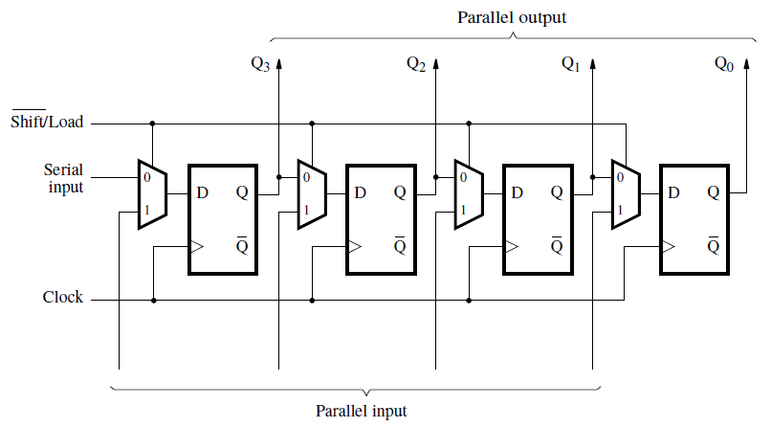
Parallel-access shift register
[ Figure 5.18 from the textbook ]

Slide 36
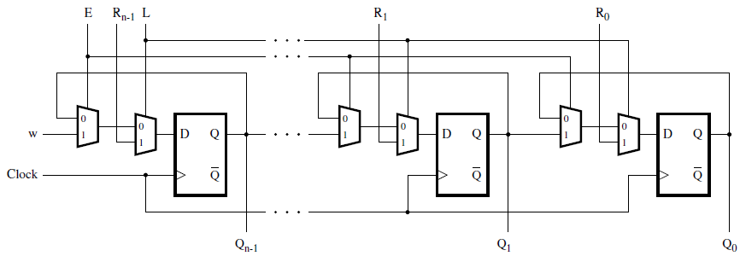
A shift register with parallel load and enable control inputs
[ Figure 5.59 from the textbook ]

Slide 37
Register File

Slide 38
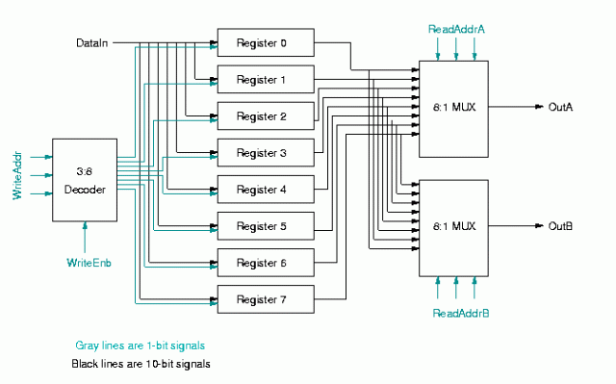
Register File
[https://jindongpu.wordpress.com/2012/03/07/register-file/]

Slide 39
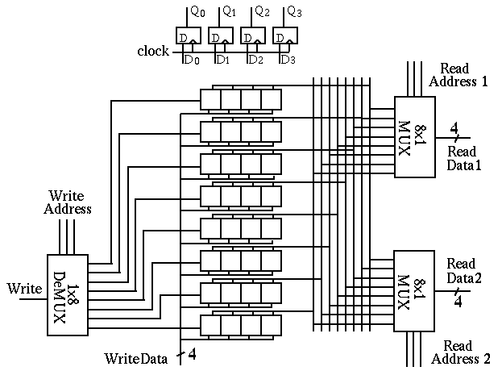
[http://fourier.eng.hmc.edu/e85_old/lectures/digital_logic/node19.html]

Slide 40
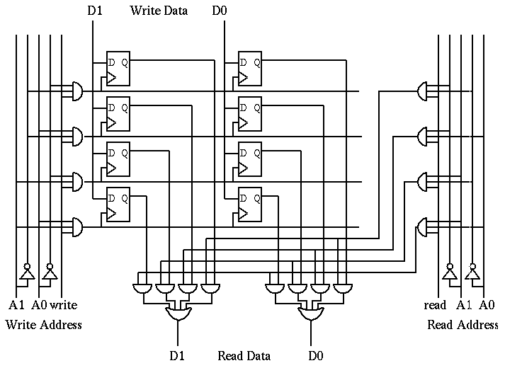
[http://fourier.eng.hmc.edu/e85_old/lectures/digital_logic/node19.html]
Notes:
This is a more detailed diagram showing only 2 of the bits in 4 of the registers:

Slide 41
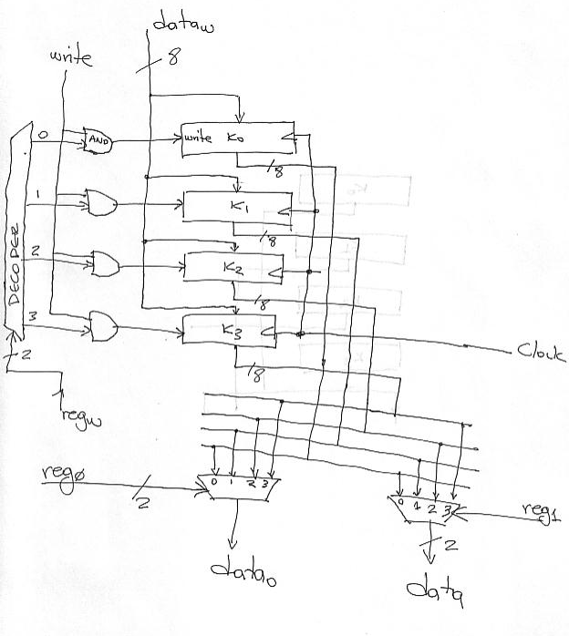
[http://www.eecg.toronto.edu/~enright/teaching/ece243S/notes/l19-implemenation-single-cycle.html]

Slide 42
Register File
Register file is a unit containing r registers
  r can be 4, 8, 16, 32, etc.
Each register has n bits
  n can be 4, 8, 16, 32, etc.
  n defines the data path width
Output ports (DATA1 and DATA2) are used for reading the register file
  Any register can be read from any of the ports
  Each port needs a log₂r bits to specify the read address (RA1 and RA2)
Input port (LD_DATA) is used for writing data to the register file
  Write address is also specified by log₂r bits (WA)
  Writing is enabled by a 1-bit signal (WR)
RA1
RA2
Reg
File
DATA1
LD_DATA
DATA2
WR
WA

Slide 43
Register File: Exercise
Suppose that a register file
  contains 32 registers
  width of data path is 16 bits
  (i.e., each register has 16 bits)
How many bits are there for each of the signals?
  RA1
  RA2
  DATA1
  DATA2
  WA
  LD_DATA
  WR
RA1
RA2
Reg
File
DATA1
LD_DATA
DATA2
WR
WA
5
5
16
16
5
16
1

Slide 44
Register file design
We will design an eight-register file with 4-bit wide registers
A single 4-bit register and its abstraction are shown below
We have to use eight such registers to make an eight register file
How many bits are required to specify a register address?
LD
D3
D2
D1
D0
LD
1
0
Q3
1
0
Q2
1
0
Q1
1
0
Q0
D3 D2 D1 D0
D
Q
D
Q
D
Q
D
Q
Q3 Q2 Q1 Q0
P
P
P
P
Clock
Clock
LD
LD
LD
D3 D2 D1 D0
D3 D2 D1 D0
D3 D2 D1 D0
Q3 Q2 Q1 Q0
Q3 Q2 Q1 Q0
Q3 Q2 Q1 Q0
Clk
Clk
Clk

Slide 45
Reading Circuit
A 3-bit register address, RA, specifies which register is to be read
For each output port, we need one 8-to-1 4-bit multiplier
Register
Address
111
001
000
LD7
LD1
LD0
D3 D2 D1 D0
D3 D2 D1 D0
D3 D2 D1 D0
Q3 Q2 Q1 Q0
Q3 Q2 Q1 Q0
Q3 Q2 Q1 Q0
Clk
Clk
Clk
7 6 5 4 3 2 1 0
8-to-1 4-bit multiplex
7 6 5 4 3 2 1 0
8-to-1 4-bit multiplex
RA1
RA2
DATA1
DATA2

Slide 46
Adding write control to register file
To write to any register, we need the register's address (WA) and a write register signal (WR)
A 3-bit write address is decoded if write register signal is present
One of the eight registers gets a LD signal from the decoder
LD_DATA
WA
LD7
LD1
LD0
D3 D2 D1 D0
D3 D2 D1 D0
D3 D2 D1 D0
3
to
8
D
e
c
o
d
e
r
LD7
111
001
000
Q3 Q2 Q1 Q0
Q3 Q2 Q1 Q0
Q3 Q2 Q1 Q0
Clk
Clk
Clk
LD2
LD1
7 6 5 4 3 2 1 0
8-to-1 4-bit multiplex
7 6 5 4 3 2 1 0
8-to-1 4-bit multiplex
LD0
RA1
RA2
WR
DATA1
DATA2

Slide 47
Counters

Slide 48
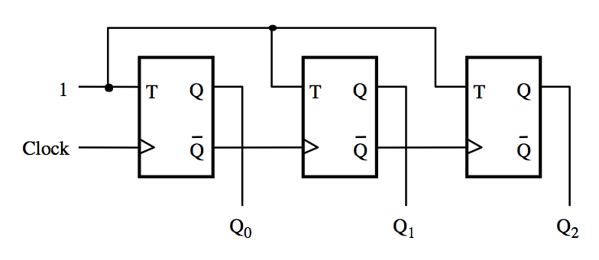
A three-bit up-counter
[ Figure 5.19 from the textbook ]

Slide 49
A three-bit up-counter
The first flip-flop changes
on the positive edge of the clock
[ Figure 5.19 from the textbook ]

Slide 50
A three-bit up-counter
The first flip-flop changes
on the positive edge of the clock
The second flip-flop changes
on the positive edge of Q₀
[ Figure 5.19 from the textbook ]

Slide 51
A three-bit up-counter
The first flip-flop changes
on the positive edge of the clock
The second flip-flop changes
on the positive edge of Q₀
The third flip-flop changes
on the positive edge of Q₁
[ Figure 5.19 from the textbook ]

Slide 52
A three-bit up-counter
1
T
Q
T
Q
T
Q
Clock
Q
Q
Q
Q
Q
Q
0
1
2
(a) Circuit
Clock
Q
0
Q
1
Q
2
Count
0
1
2
3
4
5
6
7
0
(b) Timing diagram
[ Figure 5.19 from the textbook ]

Slide 53
A three-bit up-counter
1
T
Q
T
Q
T
Q
Clock
Q
Q
Q
Q
Q
Q
0
1
2
The propagation delays get longer
(a) Circuit
Clock
Q
0
Q
1
Q
2
Count
0
1
2
3
4
5
6
7
0
(b) Timing diagram
[ Figure 5.19 from the textbook ]

Slide 54
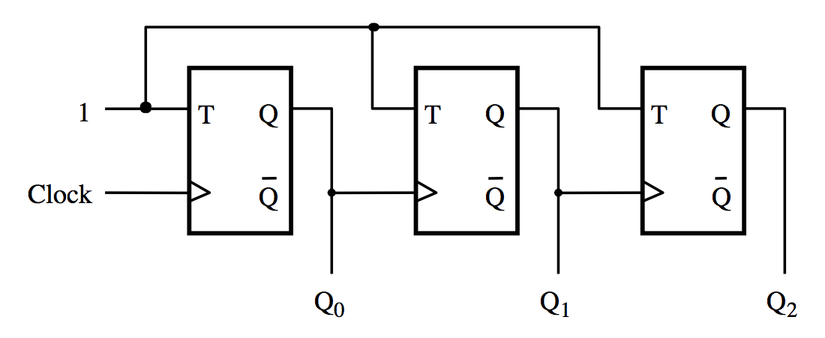
A three-bit down-counter
[ Figure 5.20 from the textbook ]

Slide 55
A three-bit down-counter
1
T
Q
T
Q
T
Q
Clock
Q
Q
Q
Q
Q
Q
0
1
2
(a) Circuit
Clock
Q
0
Q
1
Q
2
Count
0
7
6
5
4
3
2
1
0
(b) Timing diagram
[ Figure 5.20 from the textbook ]

Slide 56
Synchronous Counters

Slide 57
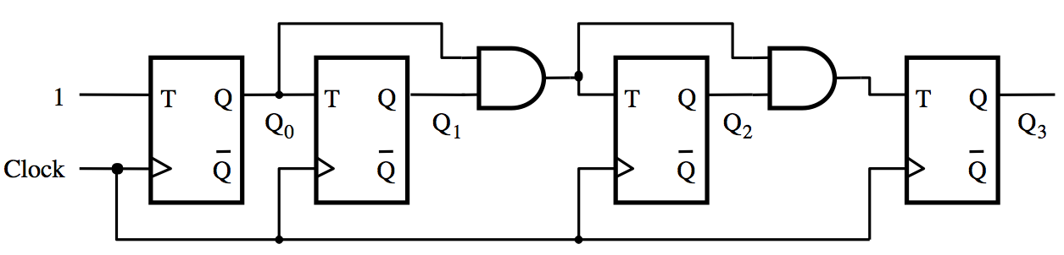
A four-bit synchronous up-counter
[ Figure 5.21 from the textbook ]

Slide 58
A four-bit synchronous up-counter
The propagation delay through all AND gates combined must
not exceed the clock period minus the setup time for the flip-flops
[ Figure 5.21 from the textbook ]

Slide 59
A four-bit synchronous up-counter
1
T
Q
T
Q
T
Q
T
Q
Q
0
Q
1
Q
2
Q
3
Clock
Q
Q
Q
Q
(a) Circuit
Clock
Q
0
Q
1
Q
2
Q
3
Count
0
1
2
3
4
5
6
7
8
9
10
11
12
13
14
15
0
1
(b) Timing diagram
[ Figure 5.21 from the textbook ]

Slide 60
Derivation of the synchronous up-counter
Clock cycle
Q
2
Q
1
Q
0
Q
changes
0
0
0
0
1
Q
changes
1
0
0
1
2
2
0
1
0
3
0
1
1
4
1
0
0
5
1
0
1
6
1
1
0
7
1
1
1
8
0
0
0
[ Table 5.1 from the textbook ]

Slide 61
Derivation of the synchronous up-counter
Clock cycle
Q
2
Q
1
Q
0
Q
changes
0
0
0
0
1
Q
changes
1
0
0
1
2
2
0
1
0
3
0
1
1
4
1
0
0
5
1
0
1
6
1
1
0
7
1
1
1
8
0
0
0
T₀= 1
T₁ = Q₀
T₂ = Q₀ Q₁
[ Table 5.1 from the textbook ]

Slide 62
A four-bit synchronous up-counter
T₀= 1
T₁ = Q₀
T₂ = Q₀ Q₁
[ Figure 5.21 from the textbook ]

Slide 63
In general we have
T₀= 1
T₁ = Q₀
T₂ = Q₀ Q₁
T₃ = Q₀ Q₁ Q₂
…
T_{n} = Q₀ Q₁ Q₂ …Q_{n-1}

Slide 64
Adding Enable and Clear Capability

Slide 65
Inclusion of Enable and Clear capability
Enable
T
Q
T
Q
T
Q
T
Q
Clock
Q
Q
Q
Q
Clear_n
[ Figure 5.22 from the textbook ]

Slide 66
Inclusion of Enable and Clear capability
This is the new thing relative to
the previous figure, plus the clear_n line
Enable
T
Q
T
Q
T
Q
T
Q
Clock
Q
Q
Q
Q
Clear_n
[ Figure 5.22 from the textbook ]

Slide 67
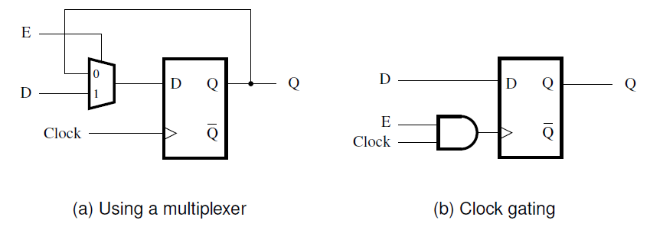
Providing an enable input for a D flip-flop
[ Figure 5.56 from the textbook ]

Slide 68
Synchronous Counter with D Flip-Flops

Slide 69
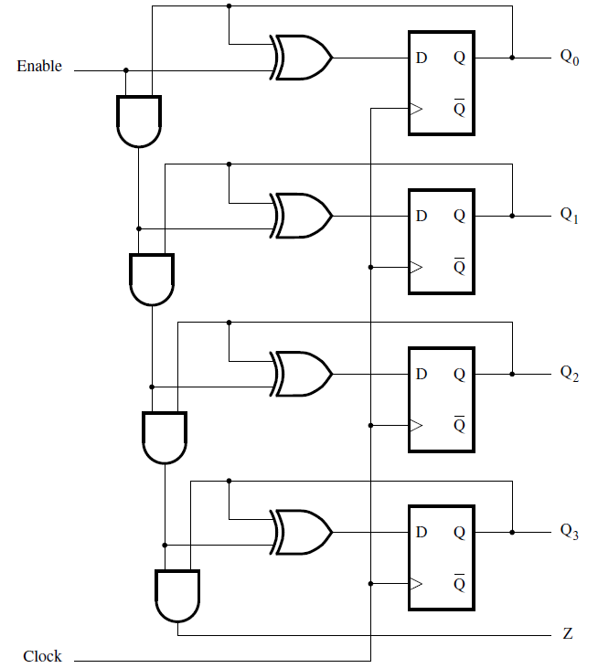
A four-bit counter with D flip-flops
[ Figure 5.23 from the textbook ]

Slide 70
Counters with Parallel Load

Slide 71
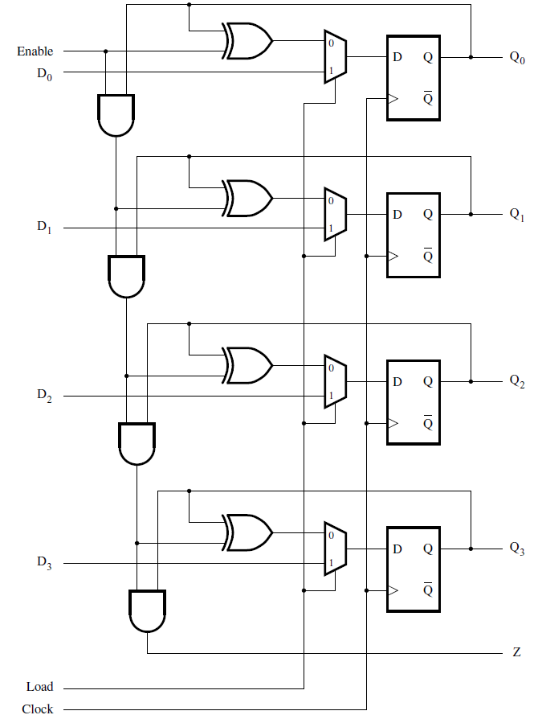
A counter with parallel-load capability
[ Figure 5.24 from the textbook ]

Slide 72
Reset Synchronization

Slide 73
Motivation
An n-bit counter counts from 0, 1, …, 2^{n}-1
For example a 3-bit counter counts up as follow
  0, 1, 2, 3, 4, 5, 6, 7, 0, 1, 2, …
What if we want it to count like this
  0, 1, 2, 3, 4, 5, 0, 1, 2, 3, 4, 5, 0, 1, …
In other words, what is the cycle is not a power of 2?

Slide 74
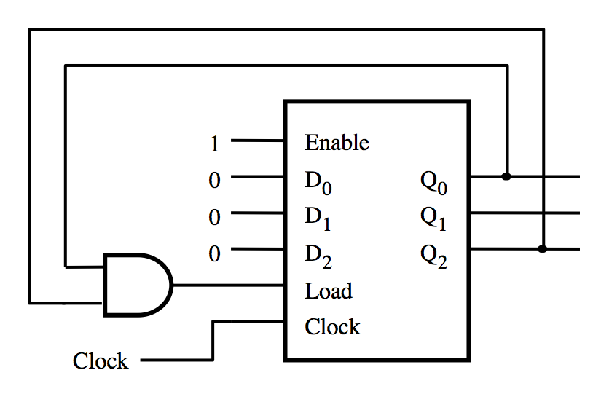
What does this circuit do?
[ Figure 5.25a from the textbook ]

Slide 75
A modulo-6 counter with synchronous reset
1
Enable
0
D
Q
0
0
0
D
Q
1
1
0
D
Q
2
2
Load
Clock
Clock
(a) Circuit
Clock
Q
0
Q
1
Q
2
Count
0
1
2
3
4
5
0
1
(b) Timing diagram
[ Figure 5.25 from the textbook ]

Slide 76
A modulo-6 counter with asynchronous reset
1
T
Q
T
Q
T
Q
Q
0
Q
1
Q
2
Clock
Q
Q
Q
(a) Circuit
Clock
Q
0
Q
1
Q
2
Count
0
1
2
3
4
5
0
1
2
(b) Timing diagram
[ Figure 5.26 from the textbook ]

Slide 77
A modulo-6 counter with asynchronous reset
1
T
Q
T
Q
T
Q
Q
0
Q
1
Q
2
Clock
Q
Q
Q
(a) Circuit
The number 5 is displayed
for a very short amount of time
Clock
Q
0
Q
1
Q
2
Count
0
1
2
3
4
5
0
1
2
(b) Timing diagram
[ Figure 5.26 from the textbook ]

Slide 78
Questions?

Slide 79
THE END

